Slide 1

Convolutional Neural Networks
Hongkai Yu
Cleveland State University

Slide 2
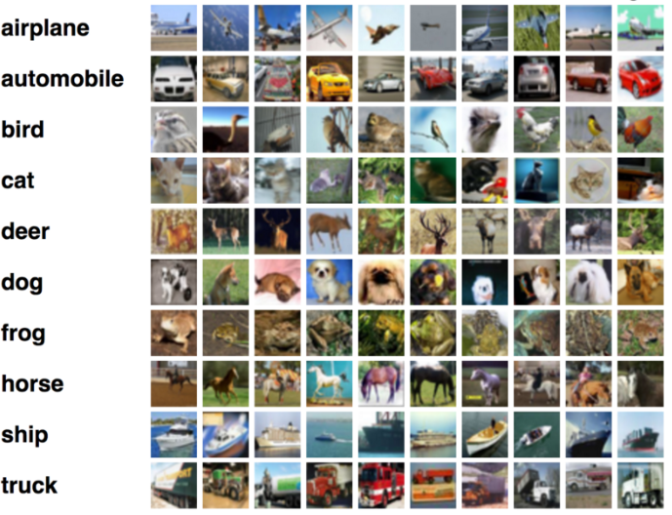
Application
Image classification

Slide 3
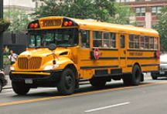
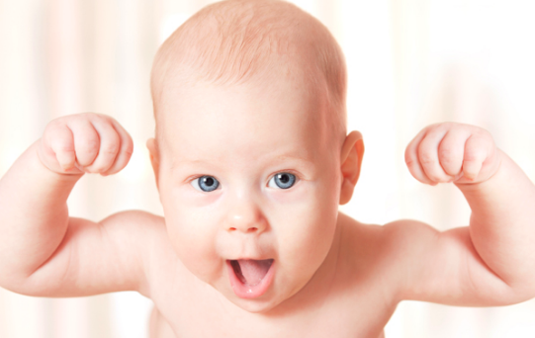
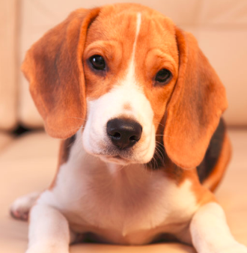
Supervised learning
Known data & known responses
class=10, bus
…
training
class=99, dog
Training Set

Slide 4
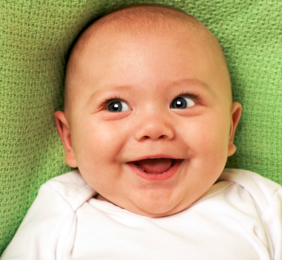
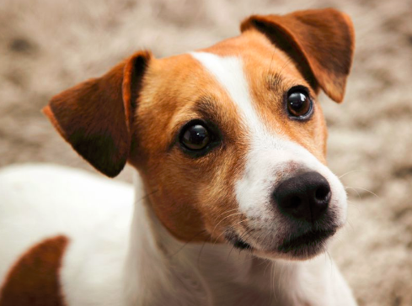
Supervised learning
new data
predicted response
testing
dog
Testing Set

Slide 5


Supervised learning
new data
predicted response
testing
?
Testing Set
Transfer learning: fine-tune, domain adaptation, etc

Slide 6
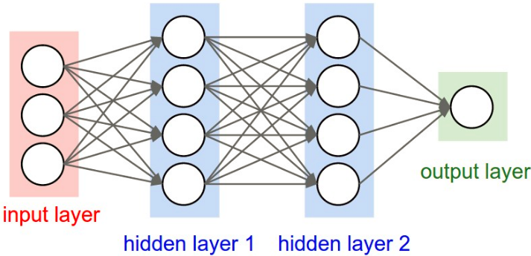
MLP
NN, Multi-layer Perceptron, Backpropagation
1970s, 1980s

Slide 7

First CNN: LeNet
Convolutional Neural Networks (CNN), 1990s
Named as LeNet
Recognize handwritten ZIP codes on mail
http://yann.lecun.com/exdb/lenet/index.html

Slide 8
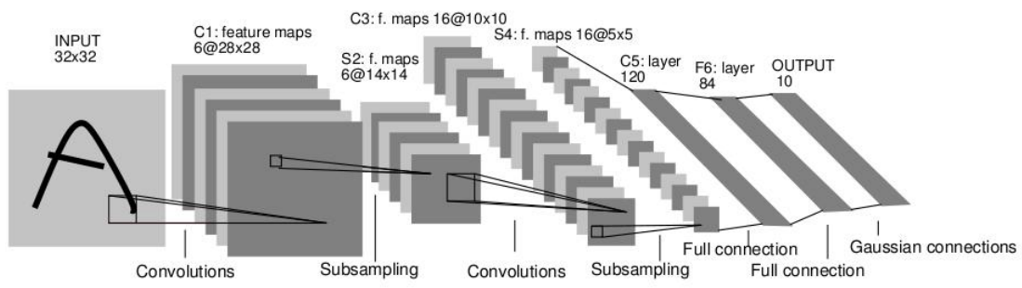
First CNN: LeNet
Convolutional Neural Networks (CNN), 1990s
LeNet is very accurate for handwritten recognition
Needs 3 days to train the LeNet on 60K images in 1990

Slide 9
Landmark CNN: AlexNet
ImageNet Dataset:
15 million images with manual annotations
Large Scale Visual Recognition Challenge, since 2010
AlexNet:
First Place in ImageNet Challenge, 2012
Image classification
Training set: 1.2 million images of 1000 classes
Testing set: 150K images of 1000 classes

Slide 10
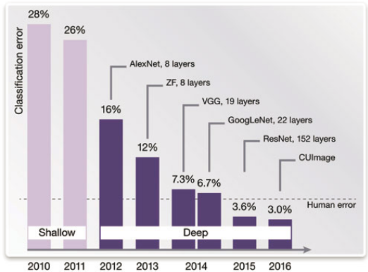
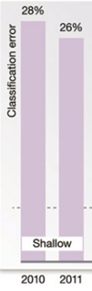
Landmark CNN: AlexNet
ImageNet Challenge

Slide 11
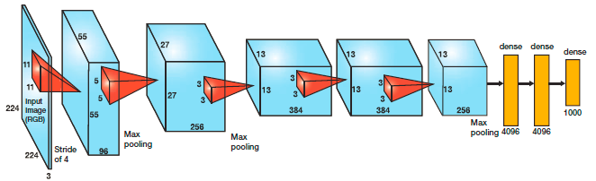
Landmark CNN: AlexNet
AlexNet for image classification, 2012
ImageNet Dataset: 1.2 million training images
Takes 5 days to train on two GTX 580 3GB GPUs

Slide 12
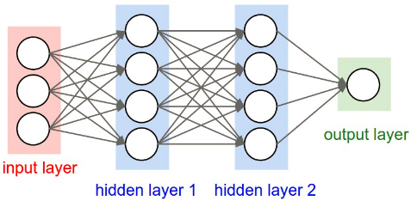
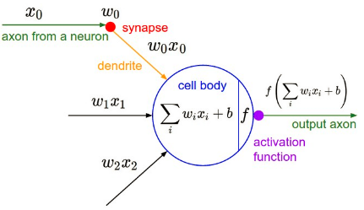
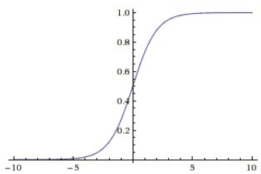
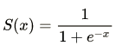
Regular NN
http://cs231n.github.io/convolutional-networks/#conv

Slide 13
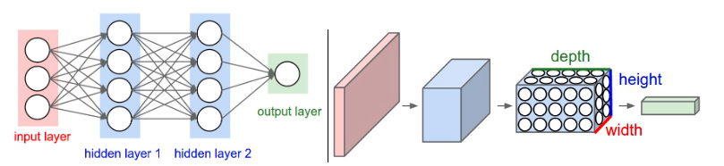
Regular NN vs CNN
W*H*3
MLP: just fully-connected layers
CNN

Slide 14
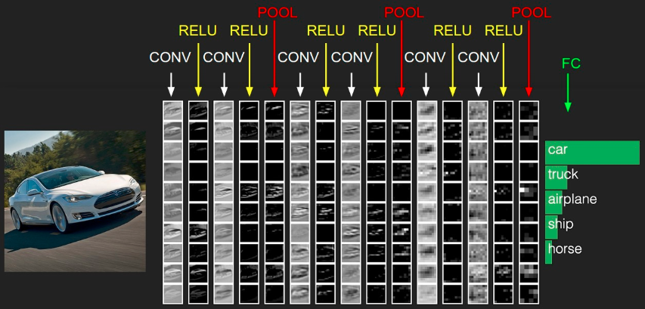
CNN

Slide 15
CNN: Convolution layer
Convolution
100 | 105 | 108 | 101 | 106
152 | 120 | 160 | 140 | 142
200 | 209 | 201 | 205 | 220
160 | 160 | 160 | 160 | 160
201 | 206 | 204 | 210 | 220
100x0+105x0+108x0+
152x1+120x(-1)+160x(-1)+
200x0+209x1+201x0
= 81
original
image
81
0
0
0
output
filter
1
-1
-1
0
1
0

Slide 16
CNN: Convolution layer
Convolution
100 | 105 | 108 | 101 | 106
152 | 120 | 160 | 140 | 142
200 | 209 | 201 | 205 | 220
160 | 160 | 160 | 160 | 160
201 | 206 | 204 | 210 | 220
105x0+108x0+101x0+
120x1+160x(-1)+140x(-1)+
209x0+201x1+205x0
= 21
original
image
81
21
0
0
0
output
filter
1
-1
-1
0
1
0

Slide 17
CNN: Convolution layer
Convolution
100 | 105 | 108 | 101 | 106
152 | 120 | 160 | 140 | 142
200 | 209 | 201 | 205 | 220
160 | 160 | 160 | 160 | 160
201 | 206 | 204 | 210 | 220
108x0+101x0+106x0+
160x1+140x(-1)+142x(-1)+
201x0+205x1+220x0
= 83
original
image
81
21
83
0
0
0
output
filter
1
-1
-1
0
1
0

Slide 18
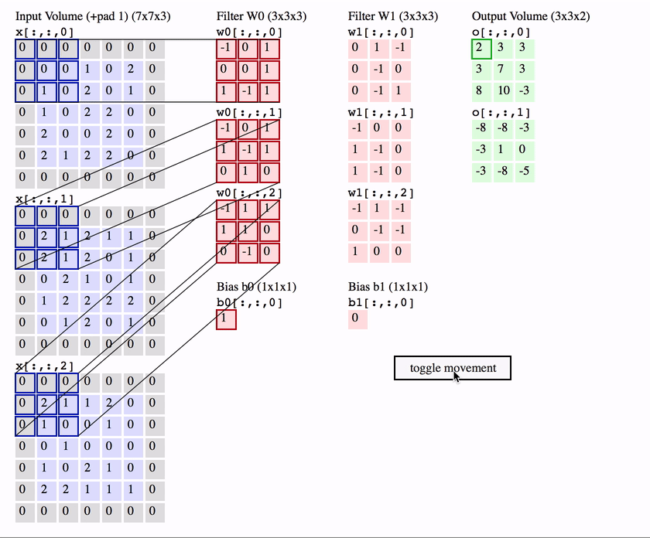
CNN: Convolution layer

Slide 19
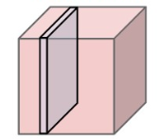
Convolution for 3-channel color image
3
One filter
H
FxFx3
W
H’xW’x1

Slide 20
Convolution for C-channel image/blob/tensor
C
One filter
…
H
W
FxFxC
H’xW’x1
…
K filters
H’xW’xK

Slide 21
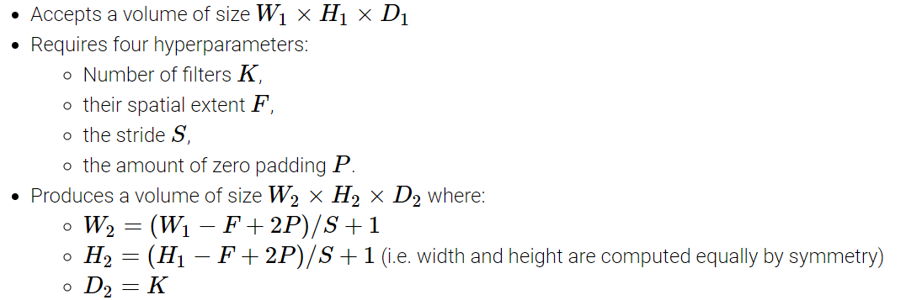
CNN: Convolution layer
Let us check the size in the previous page.

Slide 22
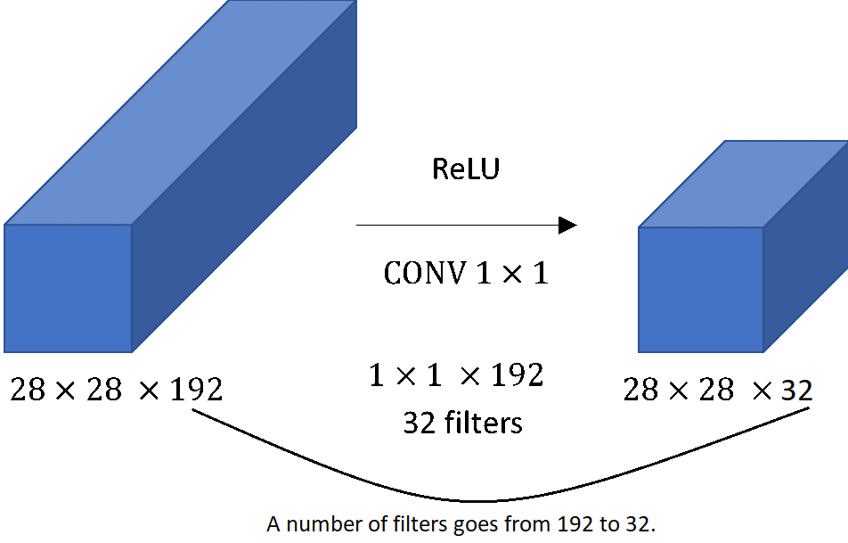
CNN: 1x1 Convolution layer

Slide 23
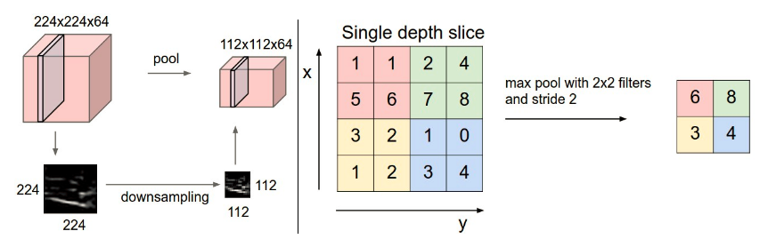
CNN: Max or Average Pooling layer
Max Pooling or Average Pooling
http://cs231n.github.io/convolutional-networks/#conv

Slide 24
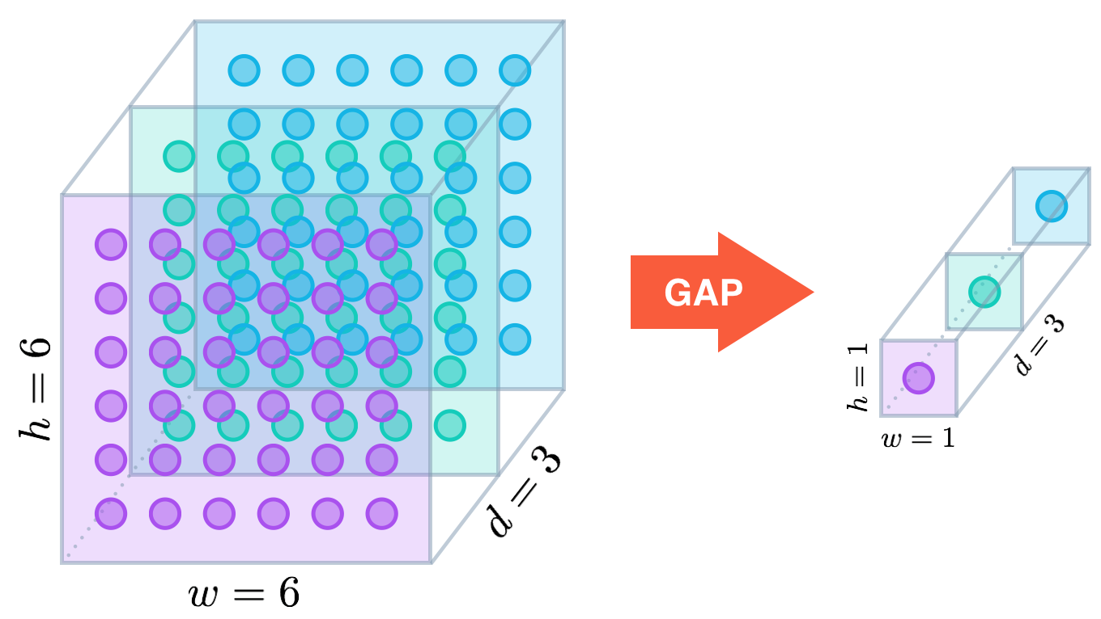
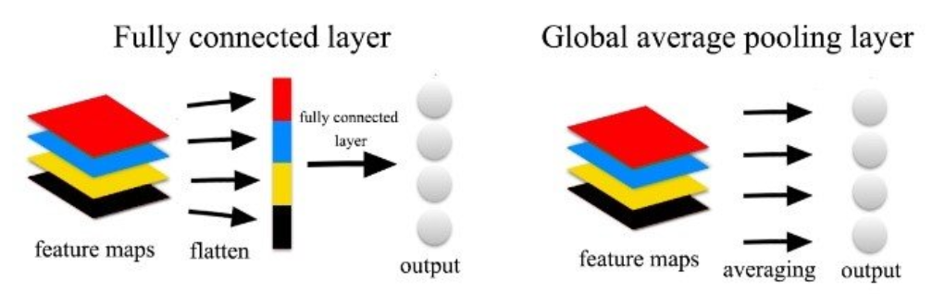
CNN: Global Average Pooling layer

Slide 25
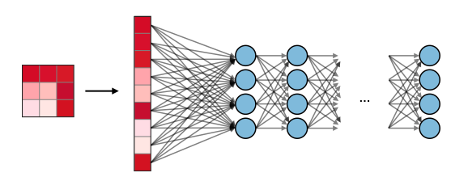
CNN: Fully-connected layer
Fully connection
flattened input
&
fully-connected layer

Slide 26
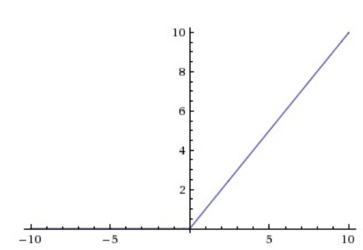
CNN: activation function layers
Rectified Linear Unit (ReLU) layer

Slide 27
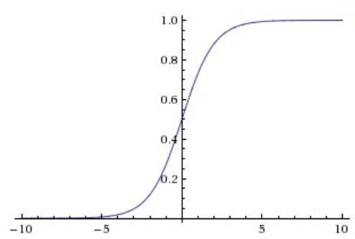
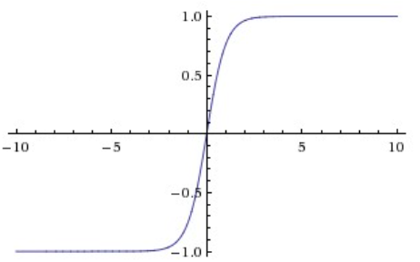
CNN: activation function layers
Sigmoid layer
Tanh layer

Slide 28
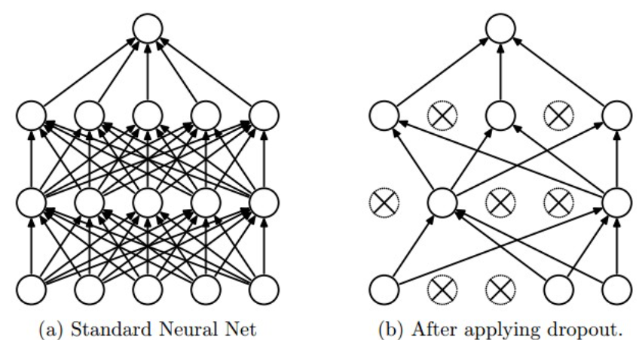
CNN: Dropout
During training:
During testing: no dropout applied

Slide 29
Training CNN
Same as training Regular NN
Mini-batch Training
Forward
Backward

Slide 30
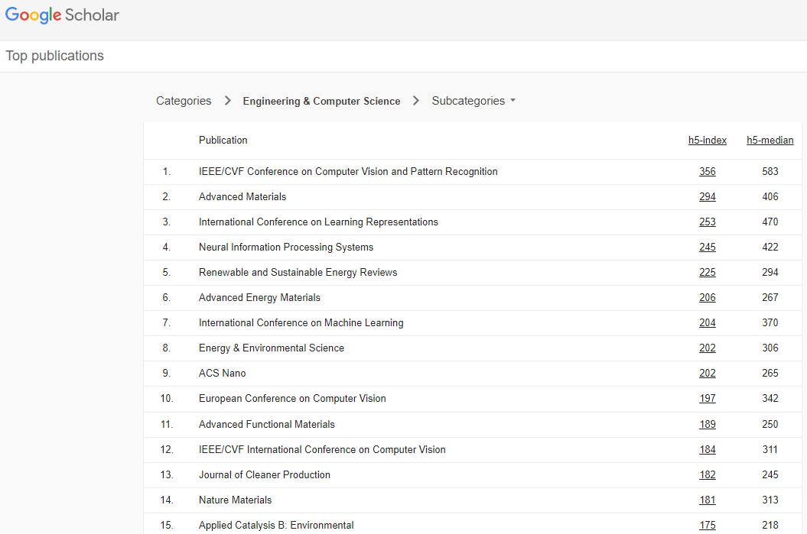
CNN Architecture

Slide 31
CNN Architecture: LeNet, 1989

Slide 32
CNN Architecture: AlexNet, 2012
ImageNet Classification Error: 16%

Slide 33
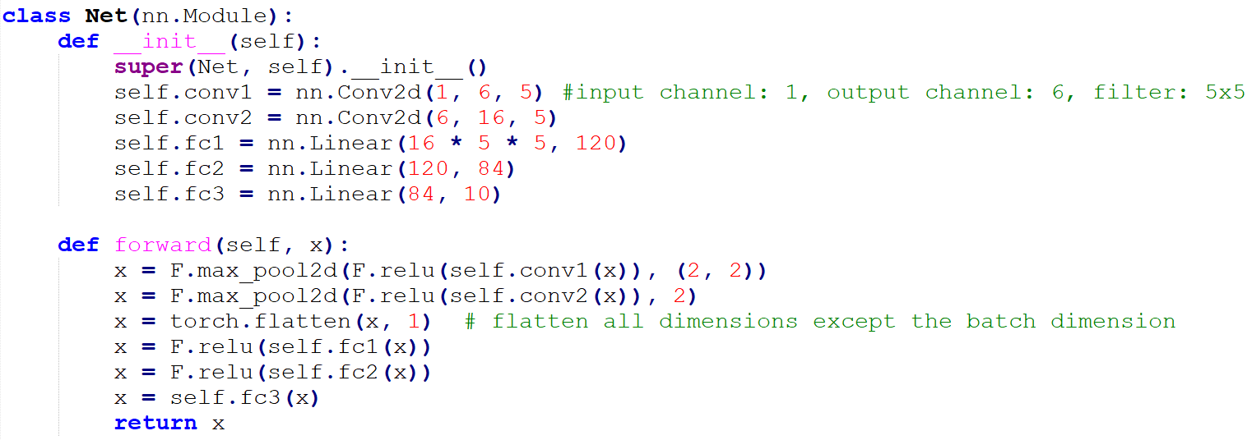
CNN Architecture: LeNet vs AlexNet

Slide 34
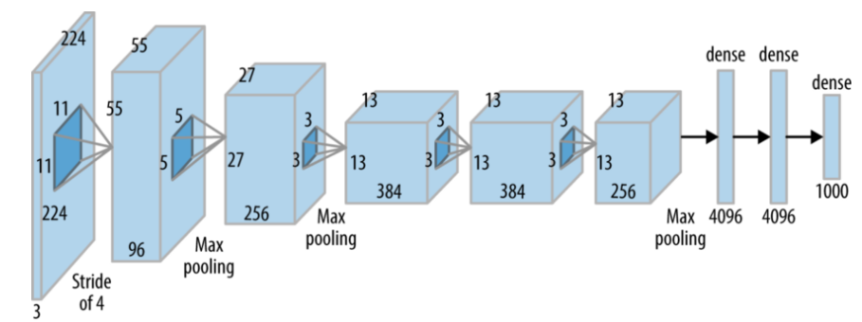
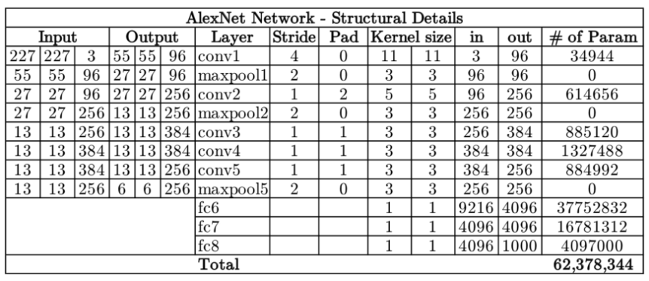
CNN Architecture: LeNet vs AlexNet

Slide 35
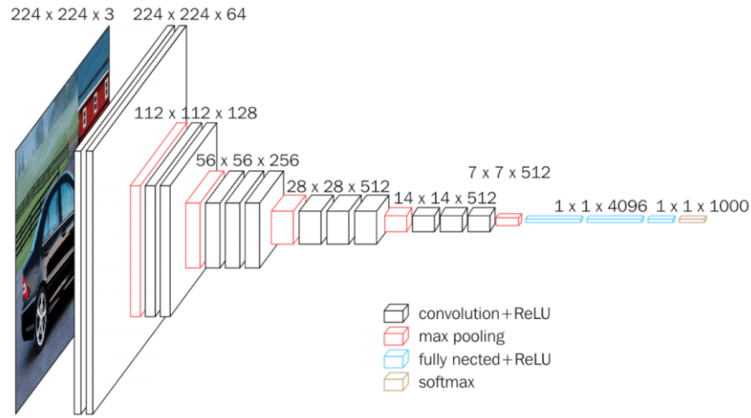
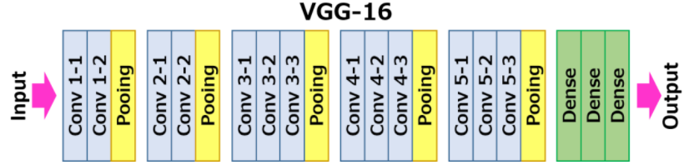
CNN Architecture: VGG, 2014
ImageNet Classification Error: 7.3%

Slide 36
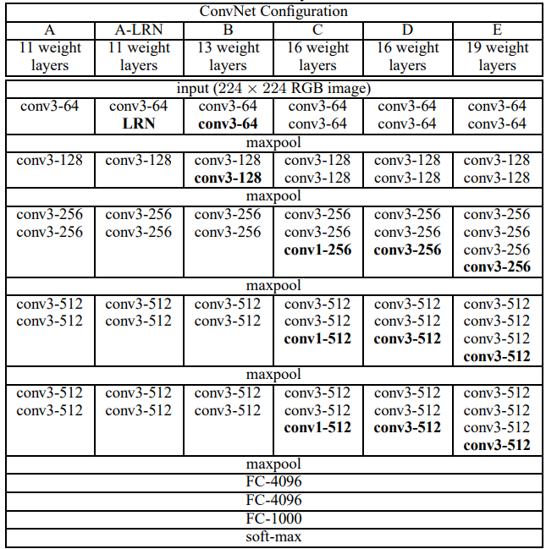
CNN Architecture: VGG, 2014

Slide 37
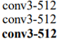
CNN Architecture: VGG, 2014
Input size == output size
if 3x3 filter, 1 stride, 1 padding
Input channel == output channel
if filter number is equal to input channel
Why is 14x14x512?

Slide 38
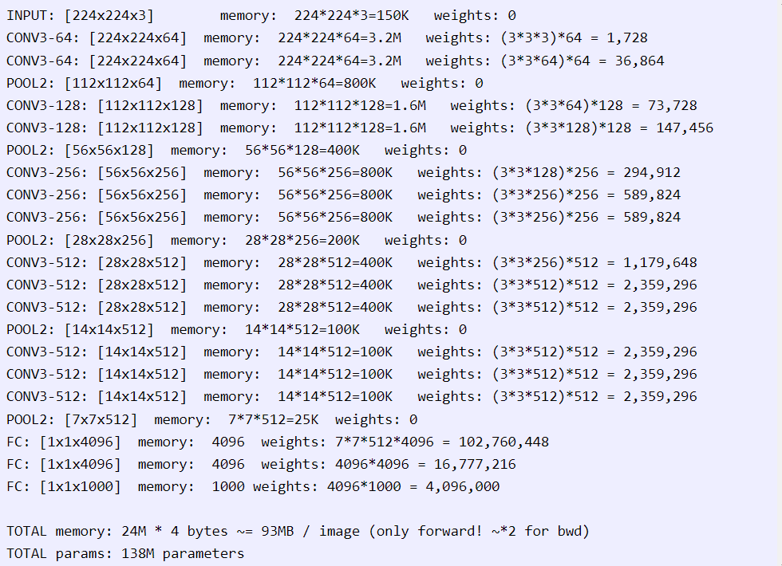
CNN Architecture: VGG, 2014
VGG16
Details:

Slide 39
CNN Architecture: after 2014
Question: the deeper the better
?

Slide 40
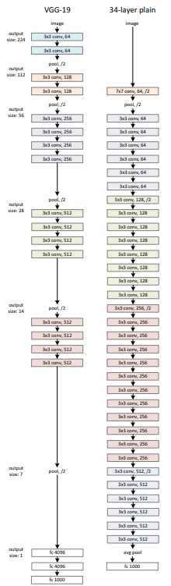
CNN Architecture: after 2014

Slide 41
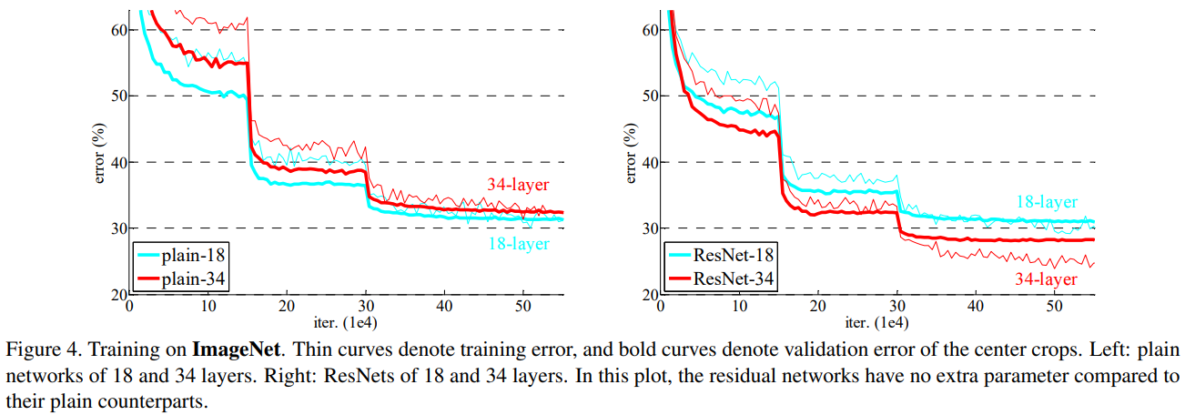
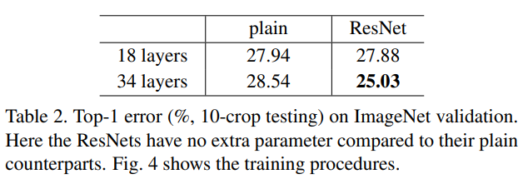
CNN Architecture: ResNet Best Paper Award of IEEE CVPR 2016

Slide 42
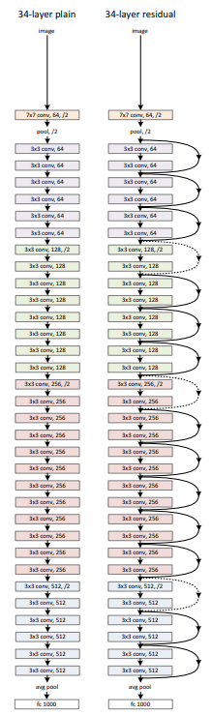
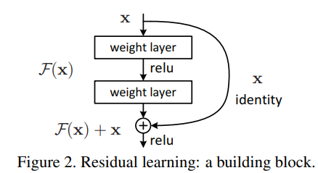
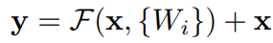
CNN Architecture: ResNet Best Paper Award of IEEE CVPR 2016

Slide 43
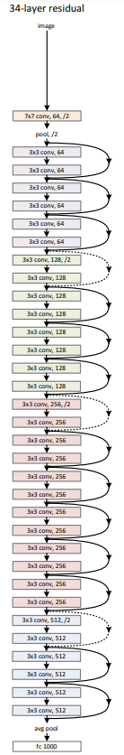
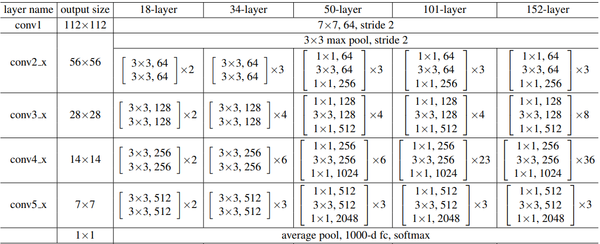
CNN Architecture: ResNet Best Paper Award of IEEE CVPR 2016

Slide 44
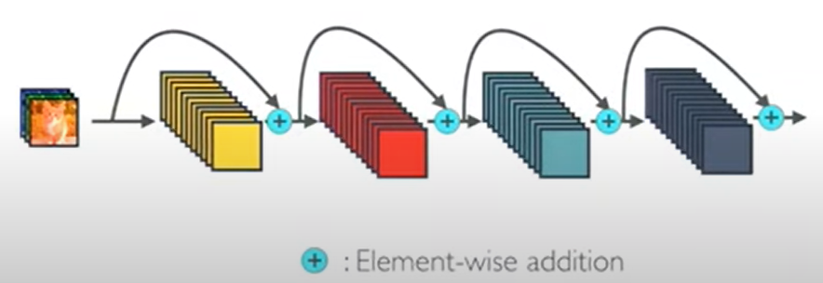
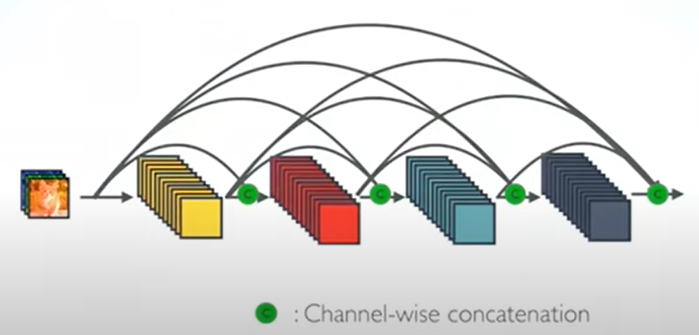
CNN Architecture: DenseNet Best Paper Award of IEEE CVPR 2017
ResNet
DenseNet

Slide 45
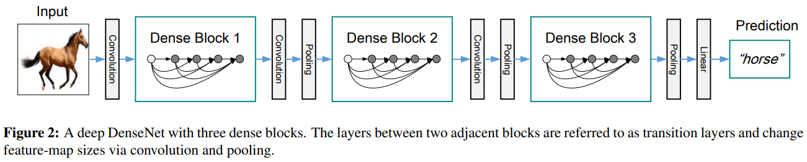
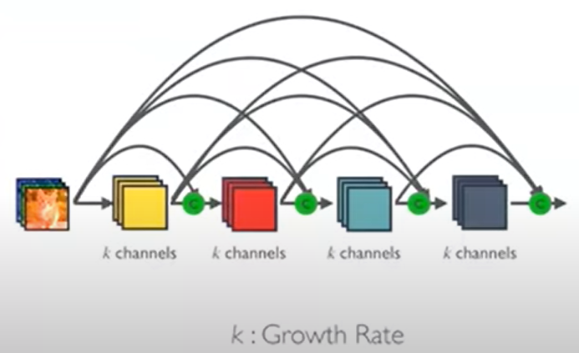
CNN Architecture: DenseNet Best Paper Award of IEEE CVPR 2017

Slide 46

CNN Architecture: DenseNet Best Paper Award of IEEE CVPR 2017

Slide 47

CNN Architecture: DenseNet Advantage 1 over ResNet: strong gradient flow

Slide 48

CNN Architecture: DenseNet Advantage 2 over ResNet: parameter & computational efficiency

Slide 49

CNN Architecture: DenseNet

Slide 50

CNN Architecture: DenseNet Best Paper Award of IEEE CVPR 2017

Slide 51

Reference:
CS231n @ Stanford University: http://cs231n.github.io/
Wikipedia
Google Images
https://www.youtube.com/watch?v=-W6y8xnd--U&ab_channel=Serrano.Academy

